Slide 1
QUALYS DEMO - PART 3
Lets have a look at some further features of Qualys:
Qualys Continuous Monitoring

Slide 2
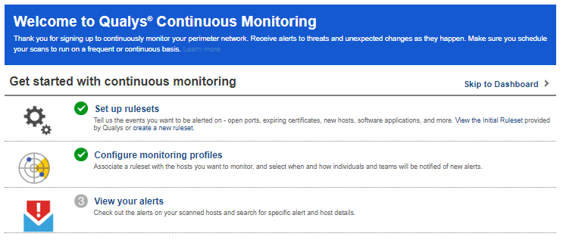
QUALYS DEMO - PART 3
QUALYS CONTINUOUS MONITORING INTERFACE

Slide 3
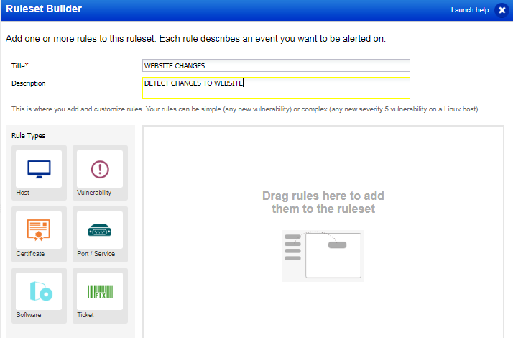
QUALYS DEMO - PART 3
RULESET BUILDER

Slide 4
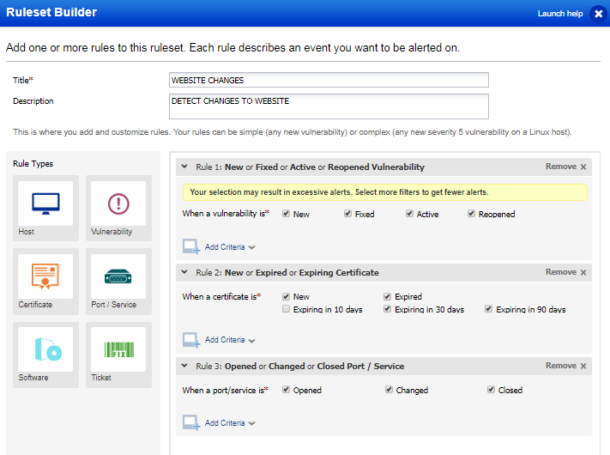
QUALYS DEMO - PART 3
RULETYPES & CONFIGURATION

Slide 5
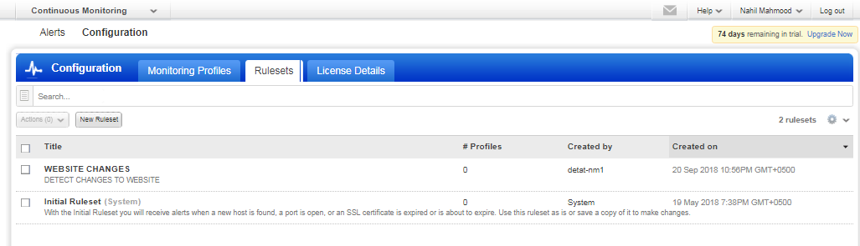
QUALYS DEMO - PART 3
RULESETS INTERFACE

Slide 6
QUALYS DEMO - PART 3
QUALYS CONTINUOUS MONITORING INTERFACE

Slide 7
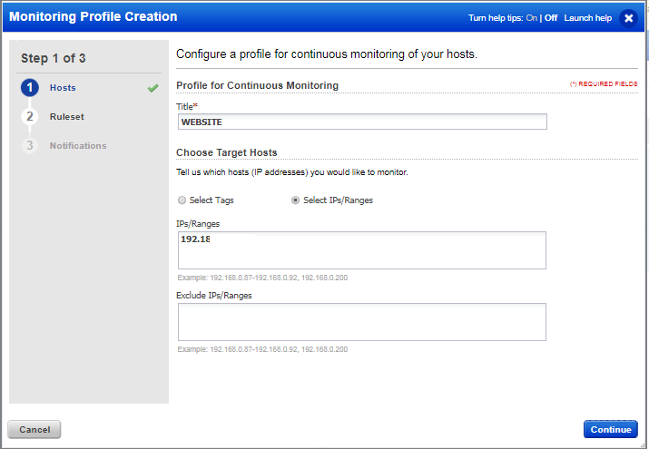
QUALYS DEMO - PART 3
PROFILE CREATION

Slide 8
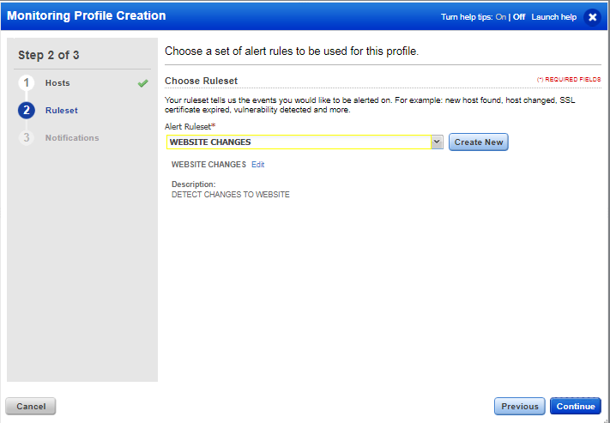
QUALYS DEMO - PART 3
CHOOSE RULESET

Slide 9
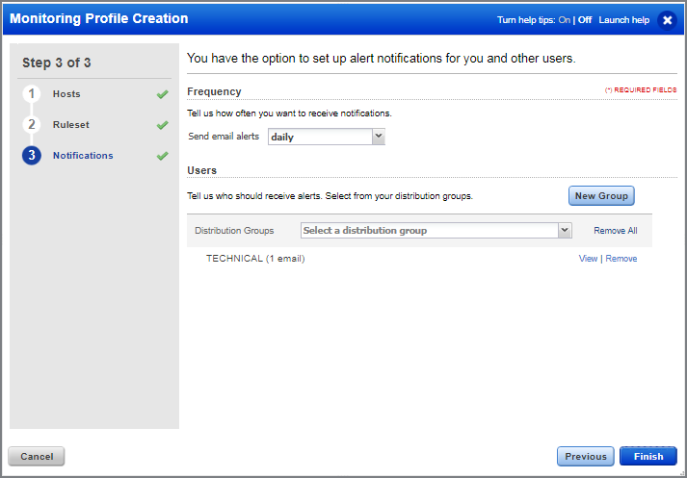
QUALYS DEMO - PART 3
NOTIFICATIONS

Slide 10
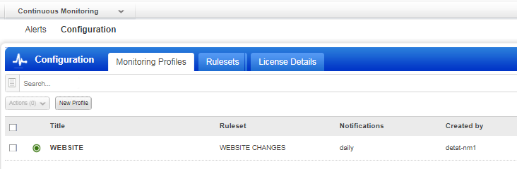
QUALYS DEMO - PART 3
MONITORING PROFILE ACTIVE

Slide 11
QUALYS DEMO - PART 3
Qualys Continuous Monitoring is very useful for watching critical changes that may impact security
END

